Slide 1
Statistical Analysis
Sample size

Slide 2
Question
Going for election
Want to carry out a survey of electorate
How many do I need to sample?
Want to estimate proportion of people who will vote for me

Slide 3
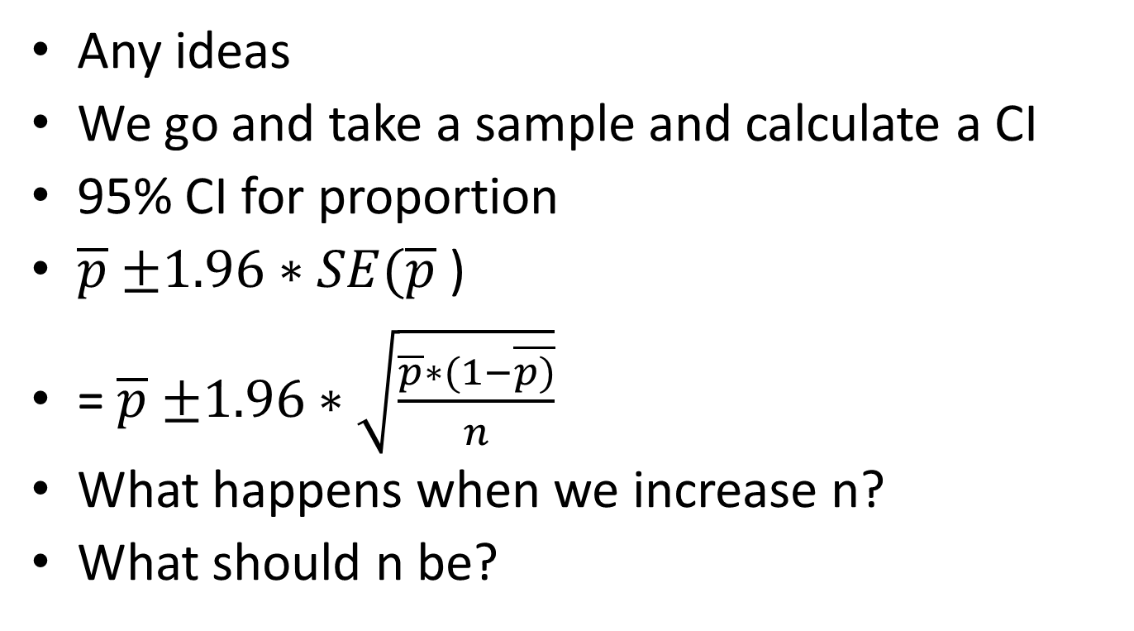
Size of sample
Any ideas
We go and take a sample and calculate a CI
95% CI for proportion
$\overline{p}$ $±1.96∗SE(\overline{p}$ )
= $\overline{p}$ $±1.96∗\sqrt{\frac{\overline{p}∗(1−\overline{p)}}{n}}$
What happens when we increase n?
What should n be?

Slide 4
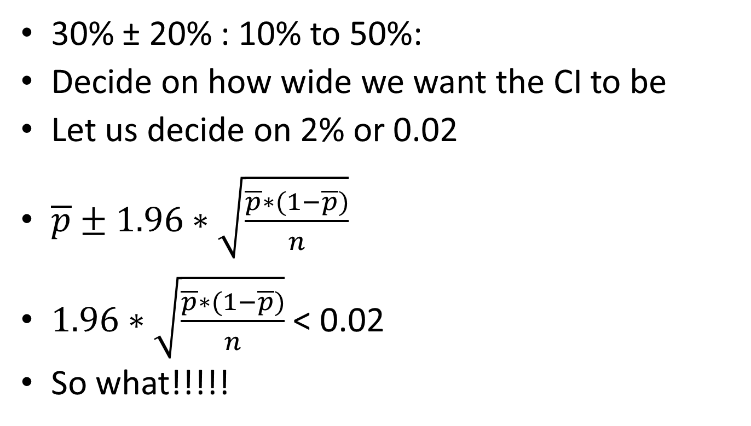
And more
30% ± 20% : 10% to 50%:
Decide on how wide we want the CI to be
Let us decide on 2% or 0.02
$\overline{p}±1.96∗\sqrt{\frac{\overline{p}∗(1−\overline{p})}{n}}$
$1.96∗\sqrt{\frac{\overline{p}∗(1−\overline{p})}{n}}$ < 0.02
So what!!!!!

Slide 5

So what is n?
$1.96∗\sqrt{\frac{\overline{p}∗(1−\overline{p})}{n}}$ < 0.02
Square everything
1.96²*$\frac{\overline{p}∗(1−\overline{p})}{n}$ < 0.02²
1.96²*$\overline{p}∗(1−\overline{p}$) < n*0.02²
n*0.02² > 1.96²*$\overline{p}∗(1−\overline{p}$)
n>$\frac{\overline{p}∗\left(1−\overline{p}\right)∗{1.96}^{2}}{{0.02}^{2}}$

Slide 6
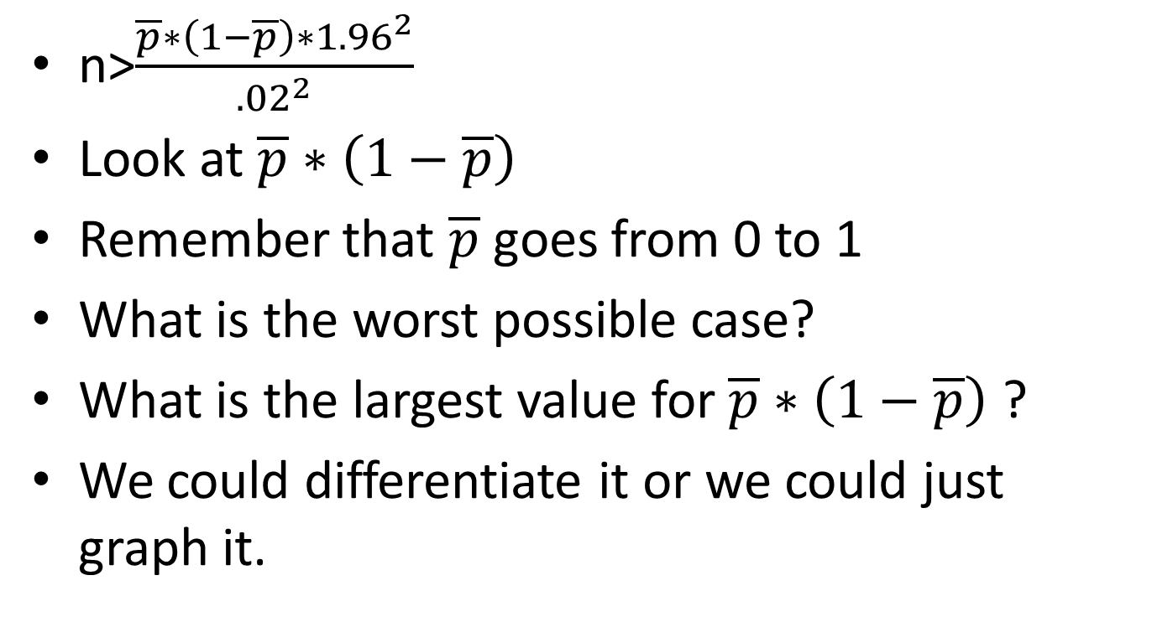
So what do we do now??
n>$\frac{\overline{p}∗\left(1−\overline{p}\right)∗{1.96}^{2}}{{.02}^{2}}$
Look at $\overline{p}∗\left(1−\overline{p}\right)$
Remember that $\overline{p}$goes from 0 to 1
What is the worst possible case?
What is the largest value for $\overline{p}∗\left(1−\overline{p}\right)$ ?
We could differentiate it or we could just graph it.

Slide 7
Graph of p*1-p

Slide 8
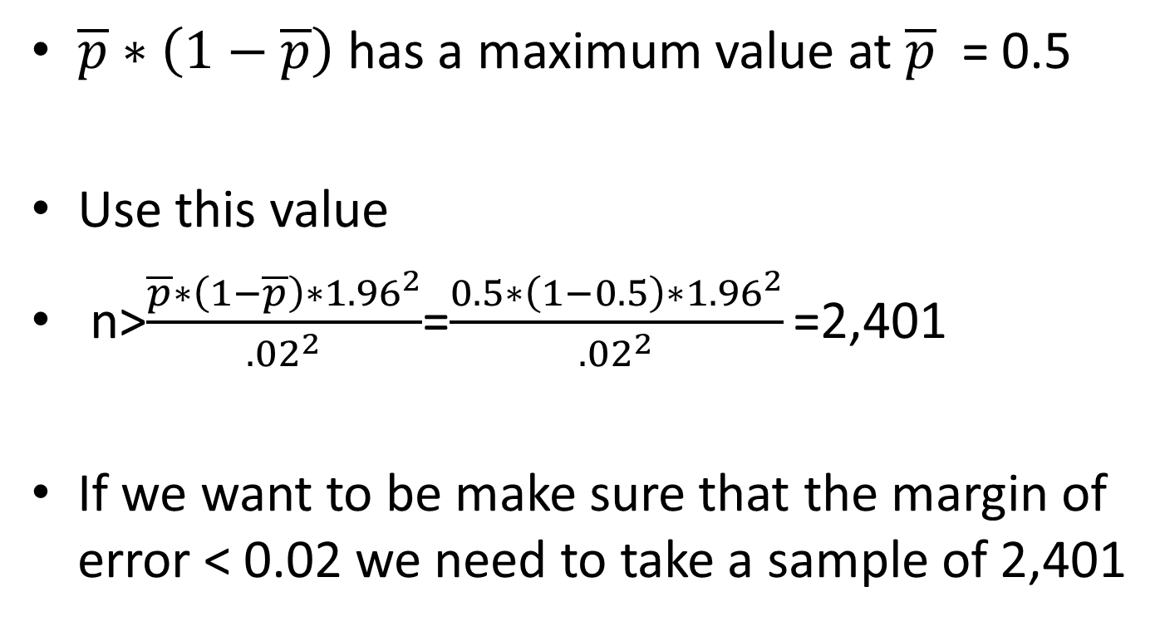
So ???
$\overline{p}∗\left(1−\overline{p}\right)$ has a maximum value at $\overline{p}$ = 0.5
Use this value
n>$\frac{\overline{p}∗\left(1−\overline{p}\right)∗{1.96}^{2}}{{.02}^{2}}$=$\frac{0.5∗\left(1−0.5\right)∗{1.96}^{2}}{{.02}^{2}}\text{=}$2,401
If we want to be make sure that the margin of error < 0.02 we need to take a sample of 2,401

Slide 9
So what
So if pick a beautiful random sample of 2,401 people
Our resulting 95% CI (half width) for a proportion will not exceed .02.
Can use smaller values for p if you have some idea beforehand.
Use value closest to 0.5

Slide 10
Sample sizes
 | Margin of error
p | 1% | 2% | 3% | 5% | 10%
10% | 3457 | 864 | 384 | 138 | 35
20% | 6147 | 1537 | 683 | 246 | 61
30% | 8067 | 2017 | 896 | 323 | 81
40% | 9220 | 2305 | 1024 | 369 | 92
50% | 9604 | 2401 | 1067 | 384 | 96
60% | 9220 | 2305 | 1024 | 369 | 92
70% | 8067 | 2017 | 896 | 323 | 81
80% | 6147 | 1537 | 683 | 246 | 61
90% | 3457 | 864 | 384 | 138 | 35

Slide 11
Guidelines
This is a guideline to determining sampling size
Takes no account of non response
It gives an idea what sample size is required
You might then decide that this is not feasible
No excuse for getting this wrong.
Many other problems to overcome

Slide 12
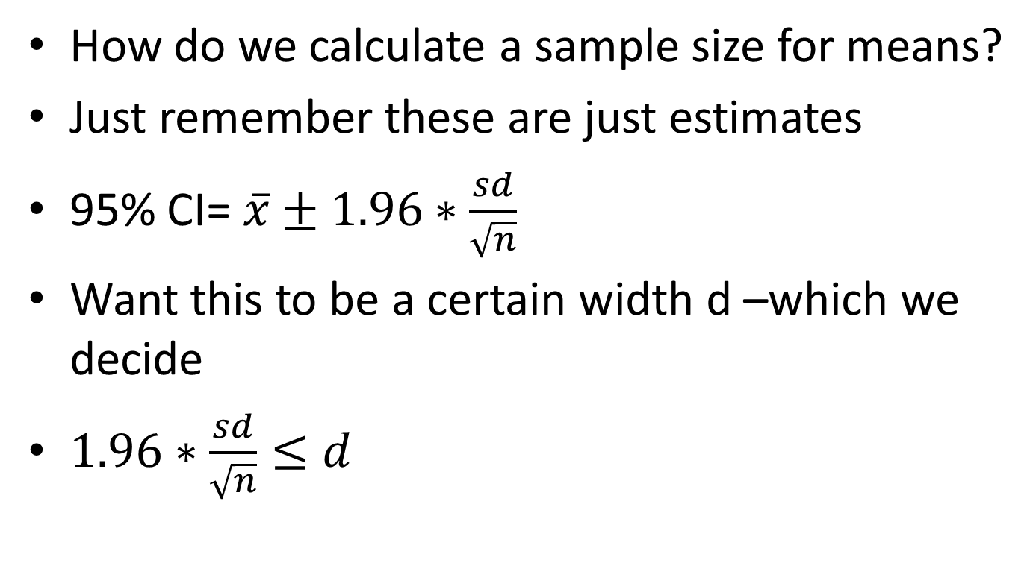
Sample sizes for estimating means
How do we calculate a sample size for means?
Just remember these are just estimates
95% CI= $\overline{x}±1.96∗\frac{sd}{\sqrt{n}}$
Want this to be a certain width d –which we decide
$1.96∗\frac{sd}{\sqrt{n}}≤d$

Slide 13

Bit of algebra
$1.96∗\frac{sd}{\sqrt{n}}≤d$
Square everything
1.96²*$\frac{{sd}^{2}}{n}$ $≤d$²
1.96^{2*}${sd}^{2}$ $≤d$²*n
$d$²*n $≥$ 1.96^{2*}${sd}^{2}$
$n≥\frac{{1.96}^{2}∗{sd}^{2}}{d^{2}}$

Slide 14
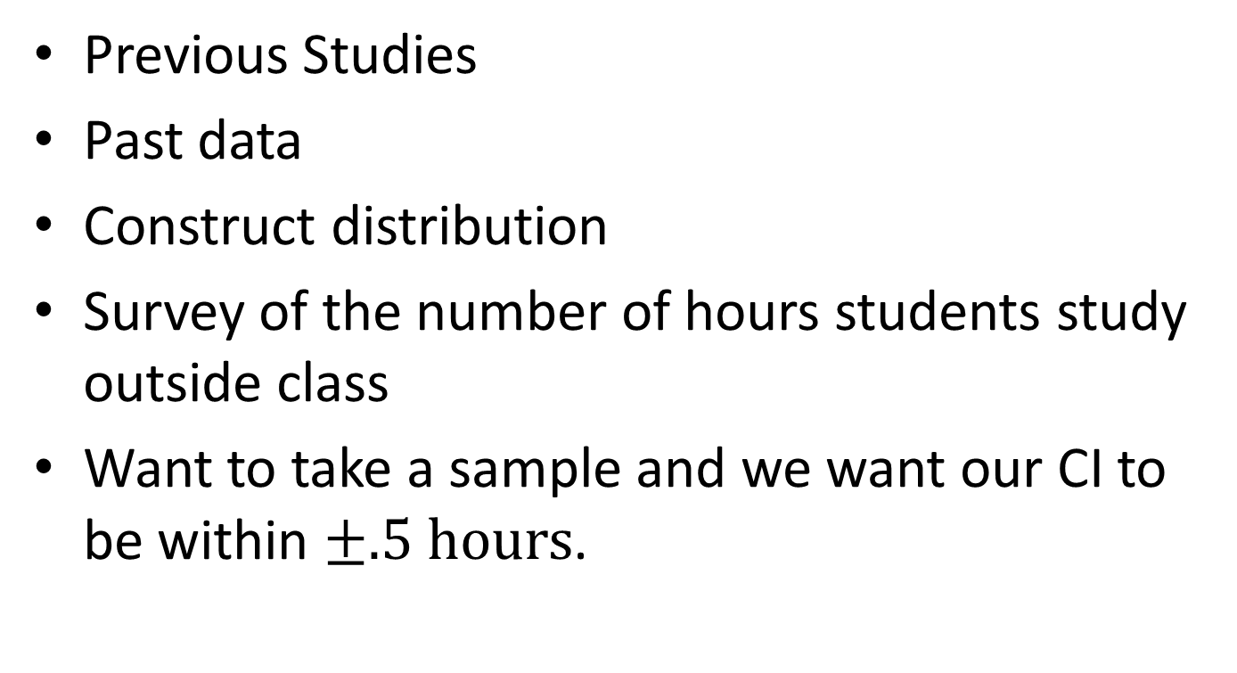
How do we estimate SD?
Previous Studies
Past data
Construct distribution
Survey of the number of hours students study outside class
Want to take a sample and we want our CI to be within $±.5 hours$.

Slide 15
Estimating SD
Take a 100 students
0-2 hours ??
2-4 hours ??
4-6 hours ??
6-8 Hours ??
8-10 Hours ??
10-12
12-14
16-18
18-20

Slide 16
And more …
Hours | Frequency
0-2 | 2
2-4 | 5
4-6 | 12
6-8 | 13
8-10 | 16
10-12 | 18
12-14 | 13
16-18 | 11
18-20 | 10
What do I do now?

Slide 17
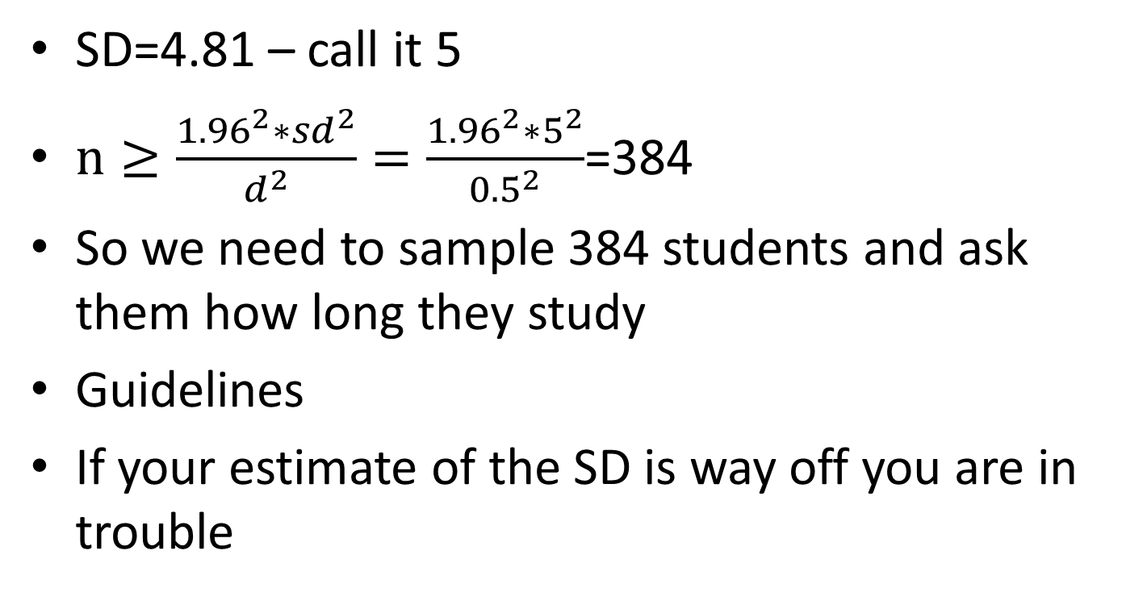
And again ..
SD=4.81 – call it 5
$n≥\frac{{1.96}^{2}∗{sd}^{2}}{d^{2}}=\frac{{1.96}^{2}∗5^{2}}{{0.5}^{2}}$=384
So we need to sample 384 students and ask them how long they study
Guidelines
If your estimate of the SD is way off you are in trouble

Slide 18
Summary
Importance of selecting a sample
You can often decide on sample size beforehand
Many variables – choose important one
Hard bit – selection of the sampling
Simple random sampling basis for all statistical techniques

Slide 19
Types of mortgage
Problem: want to take a sample of records of size n and be reasonably sure of having 50 people with a certain type of mortgage in the sample
Prevalence of type of mortgage .10 to .15
What size sample do we need?

Slide 20
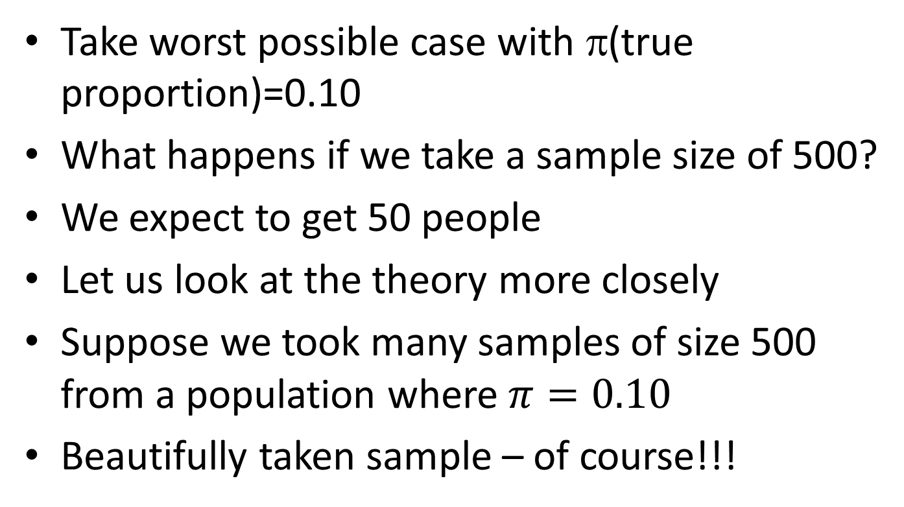
And again ….
Take worst possible case with π(true proportion)=0.10
What happens if we take a sample size of 500?
We expect to get 50 people
Let us look at the theory more closely
Suppose we took many samples of size 500 from a population where $π=0.10$
Beautifully taken sample – of course!!!

Slide 21
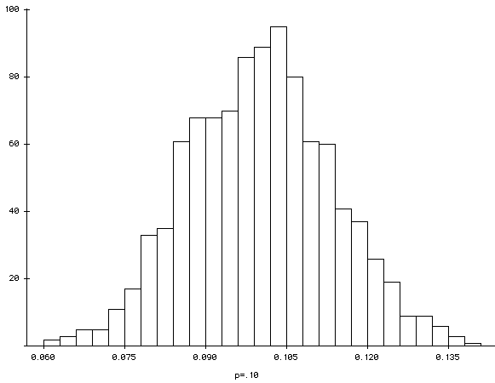
What do we get ..
Normal distribution of sample proportions centered around 0.10

Slide 22
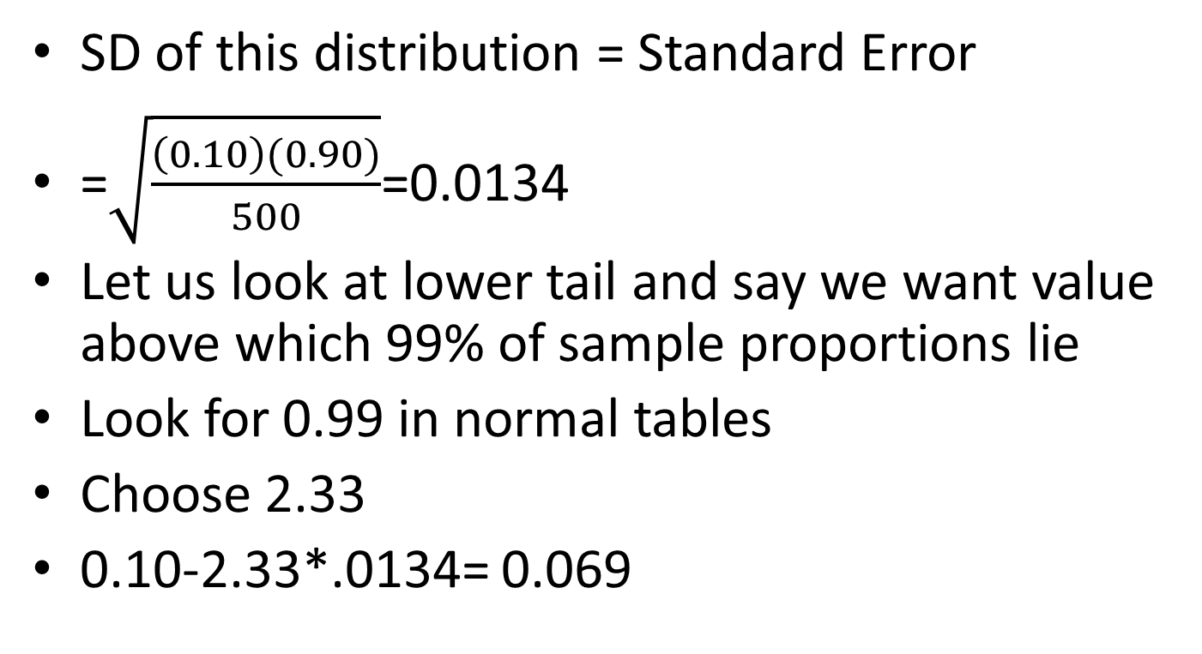
And ..
SD of this distribution = Standard Error
=$\sqrt{\frac{\left(0.10\right)(0.90)}{500}}$=0.0134
Let us look at lower tail and say we want value above which 99% of sample proportions lie
Look for 0.99 in normal tables
Choose 2.33
0.10-2.33*.0134= 0.069

Slide 23
So…
By chance we could get a sample with p as small as 0.069
Which gives us 0.069*500=34 people approx.
We want this to be 50.
34 is much lower than 50
We want to be pretty certain of getting 50
We need to take a bigger sample size
The question is how much bigger???

Slide 24
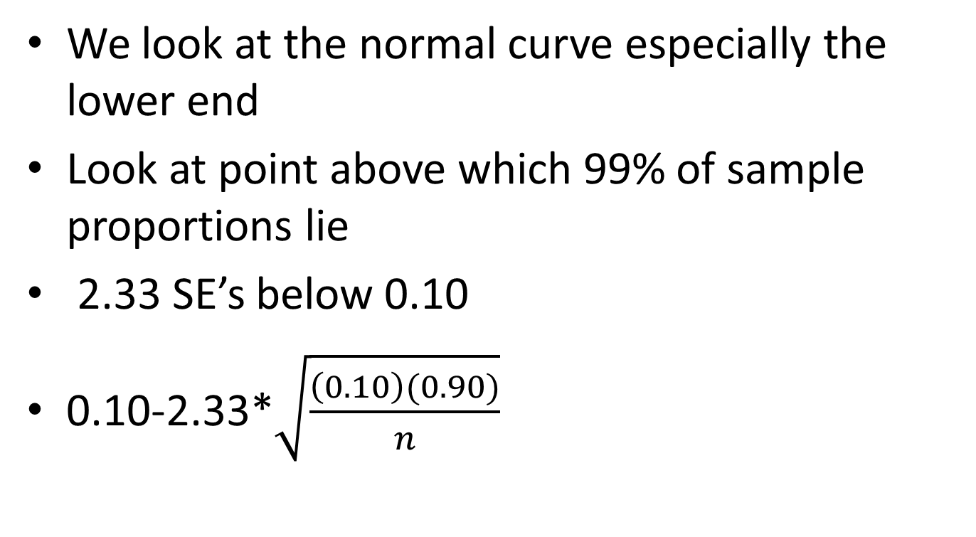
And more ….
We look at the normal curve especially the lower end
Look at point above which 99% of sample proportions lie
2.33 SE’s below 0.10
0.10-2.33*$\sqrt{\frac{\left(0.10\right)(0.90)}{n}}$

Slide 25
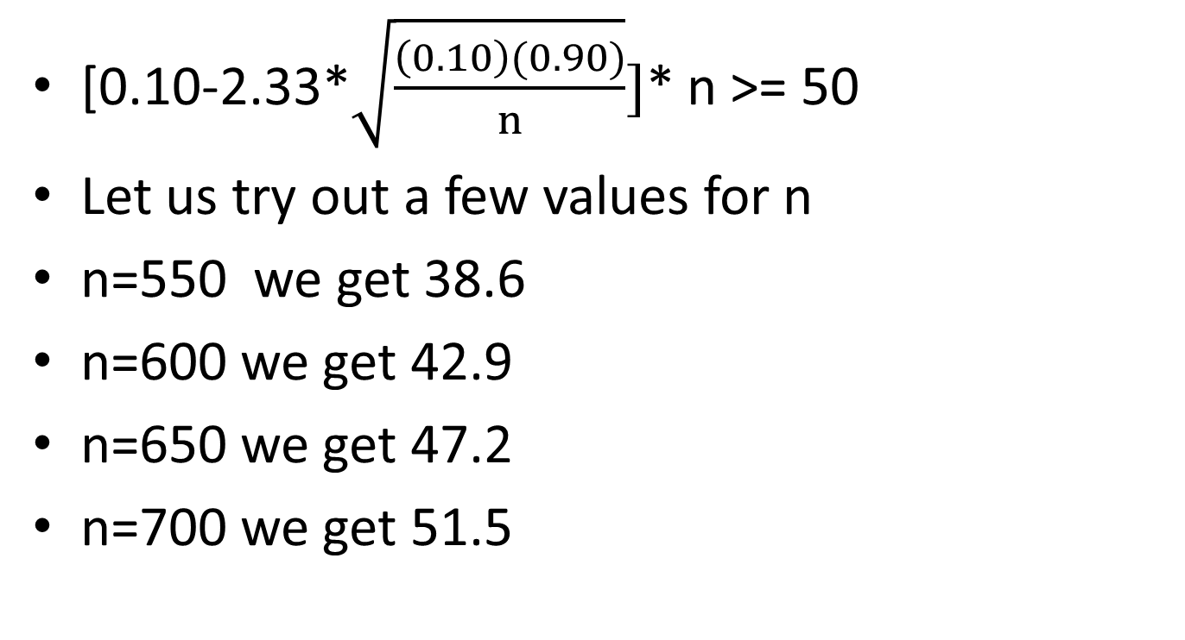
Not a pretty sight
[0.10-2.33*$\sqrt{\frac{\left(0.10\right)(0.90)}{n}}]$* n >= 50
Let us try out a few values for n
n=550 we get 38.6
n=600 we get 42.9
n=650 we get 47.2
n=700 we get 51.5

Slide 26
Some more figures
I used EXCEL to do this
n | group size
550 | 38.6
600 | 42.9
650 | 47.2
680 | 49.8
685 | 50.2
690 | 50.6
700 | 51.5

Slide 27
Remember
We need to pick a sample of about 680
We should be reasonably sure of having at least 50 people with the certain type of mortgage
Assumes we are going to take simple random sampling.
Gives some idea of where to start.
What assumptions did we make?

Slide 28
Key points
We can use theory to get some estimate of what size sample we need
This is the easy bit
The hard part is selecting the sample beautifully.

